Slide 1

Heat Transfer
with Plate

Slide 2
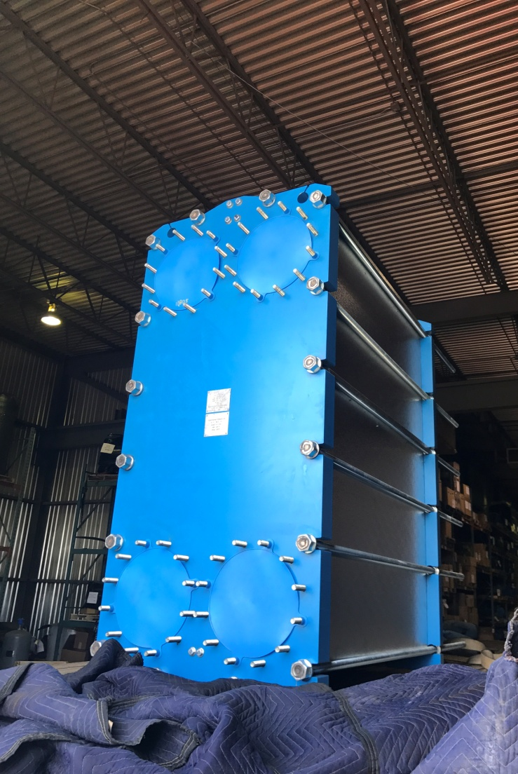

Plate Heat Exchangers - Plate

Slide 3
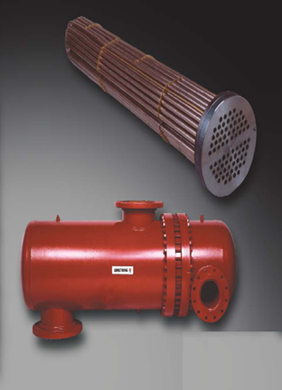
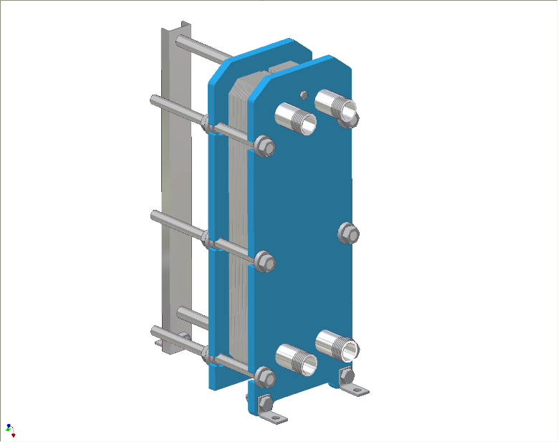

What is best heat transfer choice?
Shell & Tube: Heavy Duty
Plate: Efficient

Slide 4
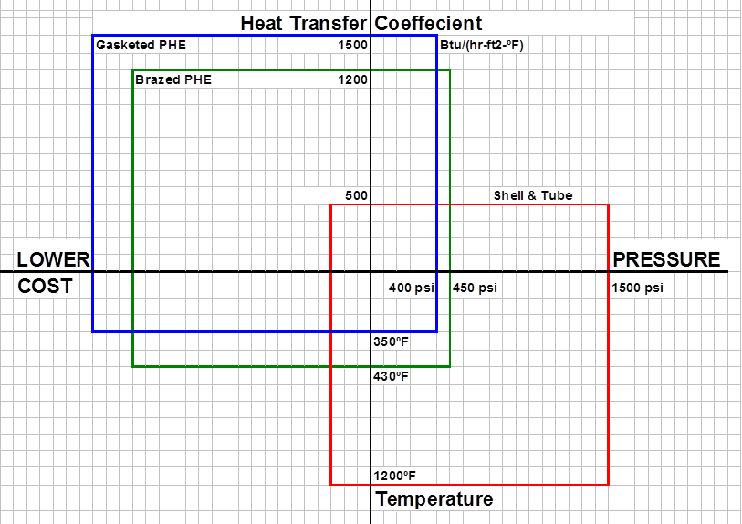
What is best choice?
Tubes: Higher Pressure & Temperature Limits
Plates: Higher Coeffecient = Lowest Cost

Slide 5

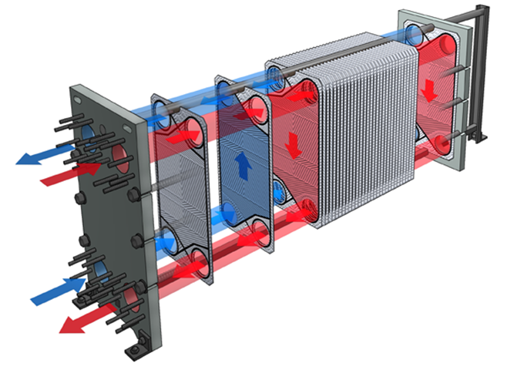

Fluids channeled in opposite directions on alternating plates for efficiency.

Slide 6
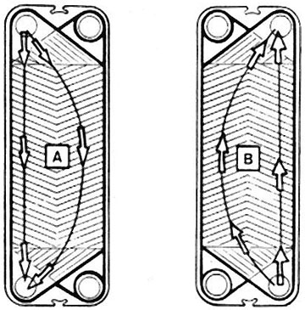
How it works
  Plates are parallel or same side flow (not diagonal)
  Rotating plate 180° puts flow on opposite side and direction

Slide 7

How it works
High turbulence
True counter current flow path
Low fouling from scouring action of flow
Highest heat transfer coefficients

Slide 8

Heat Transfer Coefficients
Heat transfer coefficients: Btu / Hr – Ft2 - F
Application S & T Plate
Water/Water 400-500 1400-1500
  Higher heat transfer coeffecients mean lower surface area and lower cost
  Higher coeffecients and lmtd’s result in lower surface area and cost – see next page

Slide 9
Drivers: Coefficient & Temperature Difference
$
Surface Area = Q =
U x LMTD
Q = Heat transfer duty = Btu/hr
U = Overall heat transfer coefficient = Btu/hr.sqft.F
LMTD = Log mean temperature difference = °F
= ( Thot in – Tcold out ) – ( Thot out – Tcold in )
ln ( Thot in – Tcold out )
( Thot out – Tcold in )

Slide 10
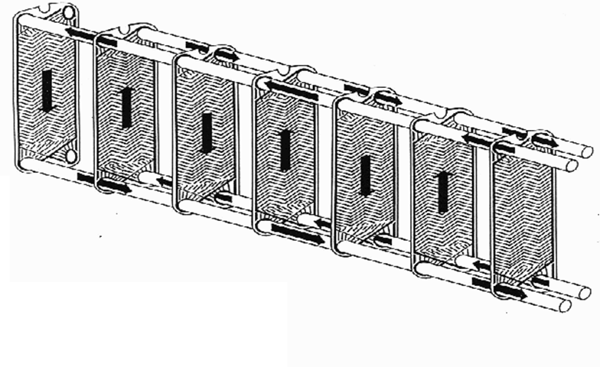
Flow Arrangement – One Pass
  All connections on fixed end
  Single pass only may be specified.

Slide 11
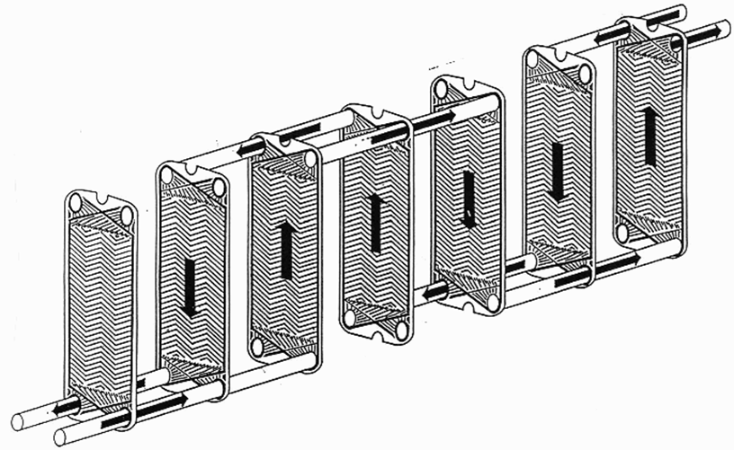
Flow Arrangement – Multi Pass
  Connections on moveable end – must disconnect for servicing

Slide 12
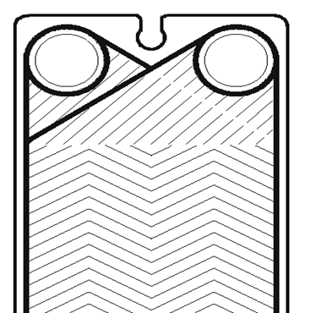
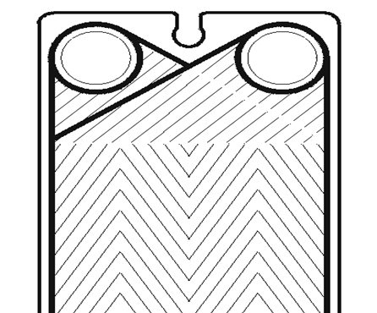
Two corrugation types; H, L
H
L
  30° Chevron
  High Press Drop
  High Heat Transfer
  60° Chevron
  Low Press Drop
  Lower Heat Transfer

Slide 13
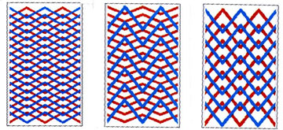

Flow Path
H – H H – L L - L

Slide 14
PHE Benefits
LOWER
VOLUME
HIGH HEAT
TRANSFER
COEFFICIENTS
COMPACT
DESIGN
LESS
MATERIAL
LOWEST
INSTALLED
COST!

Slide 15
Factors in Choosing a PHE
  Design Pressure
  Design Temperature
  Temperature Crossing
  Corrosive Fluids
  Particles in Fluids
  Fouling / Cleanability

Slide 16
Pressure / Temperature Limits
Designed For:
Pressures up to 300 psi (new plate stamping technology now allows for over 400 psi)
Temperatures: -10°F to +320°F

Slide 17
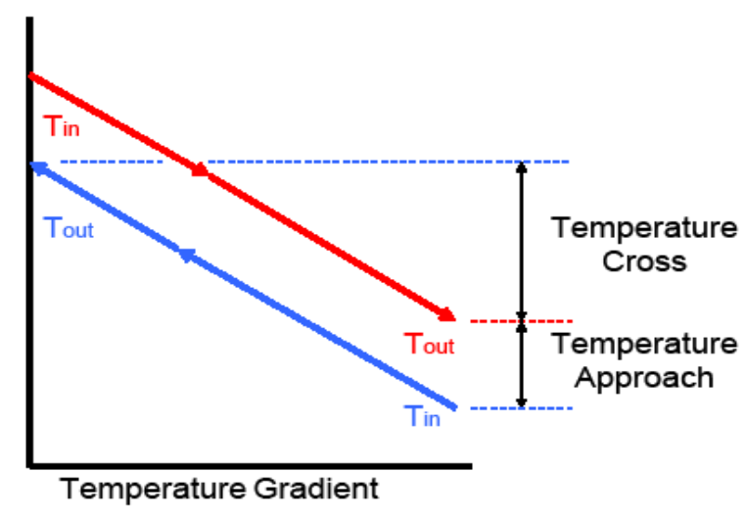
Temperature Crossing and Approach

Slide 18
Temperature Crossing
  Temperature crossing not possible in shell & tube not pure counterflow

Slide 19
PHE Benefits
TEMPERATURE
CROSSING
COUNTER
CURRENT
FLOW
GREATER
HEAT
RECOVERY
CLOSER
APPROACH
TEMPERATURE
LOWER
ENERGY
COSTS!

Slide 20
Corrosive Fluids
  Swimming pools and open groundwater heat pumps can be high in chlorides
  304SS plates good to 75 ppm Cl
  316SS plates good to 200 ppm chlorides
  Titanium plates good for greater than 200 ppm chlorides

Slide 21
Particles in the Fluids
  Open cooling towers and ponds can be high in particles
  Standard plates can pass particles that are 75% of the free channel ( 1/16” to 1/8” for standard plates)
  Provide an appropriate strainer in the heat exchanger inlet
  Flow fluids with particles downward in heat exchangers
  Provide back flushing system to periodically clean the unit

Slide 22
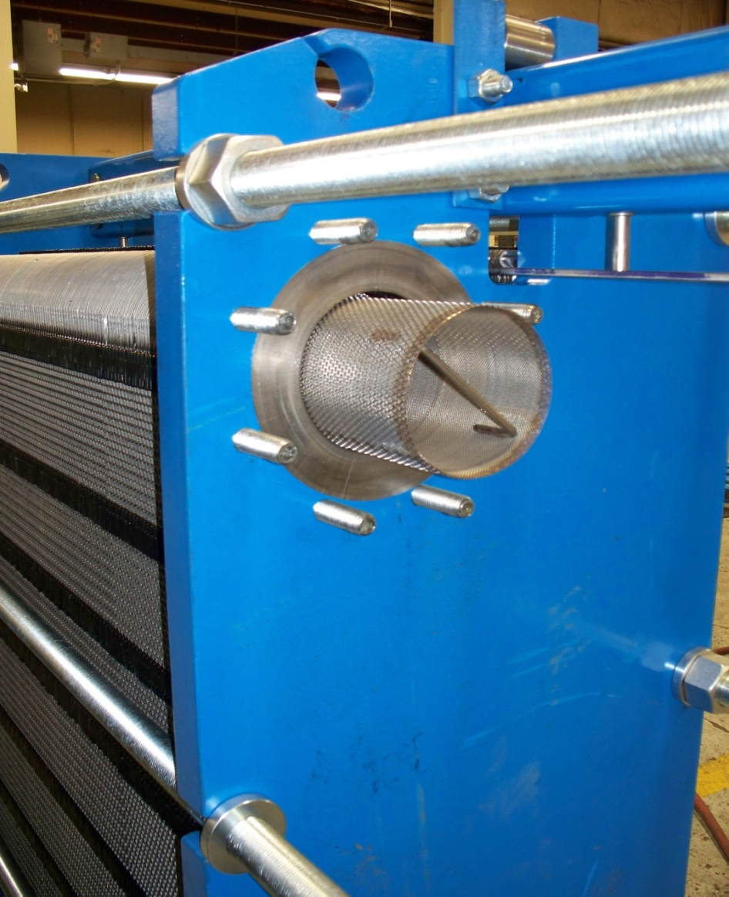
In Line Port Strainers
  Removable Port Strainer
  Removed via moveable rear head

Slide 23
Fouling Factors / Cleanability
Fouling – The build up of an unwanted substance (dirt, minerals, etc) on a heat transfer surface area
Reduces heat transfer capabilities
Fouling Factor – a “fudge factor” that over sizes the heat transfer device in order to overcome fouling.
Fouling factor = Excess heat transfer surface area
Excessive fouling factors add dead heat transfer surface to a plate heat exchanger causing lower performance from less velocity across the plate.

Slide 24
Fouling Factors
The term “Fouling Factor” was developed by TEMA (Tubular Exchanger Manufacturing Association)
It is needed as S&T heat exchangers are not symmetrical (shell side Vs tube side) and therefore should not have the same amount of excess surface area added to each side.

Slide 25
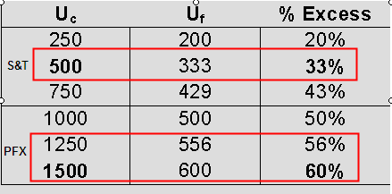
Fouling Factors
1/Uf = 1/Uc + FF
  where Uf is the fouled overall heat transfer rate
  where Uc is the clean overall heat transfer rate
using typical S&T FFs of 0.001 ft2F/Btu yields;
10% Excess Surface should be specified or FFs in 0.0001 to 0.0005 range

Slide 26
Frame Construction

Slide 27
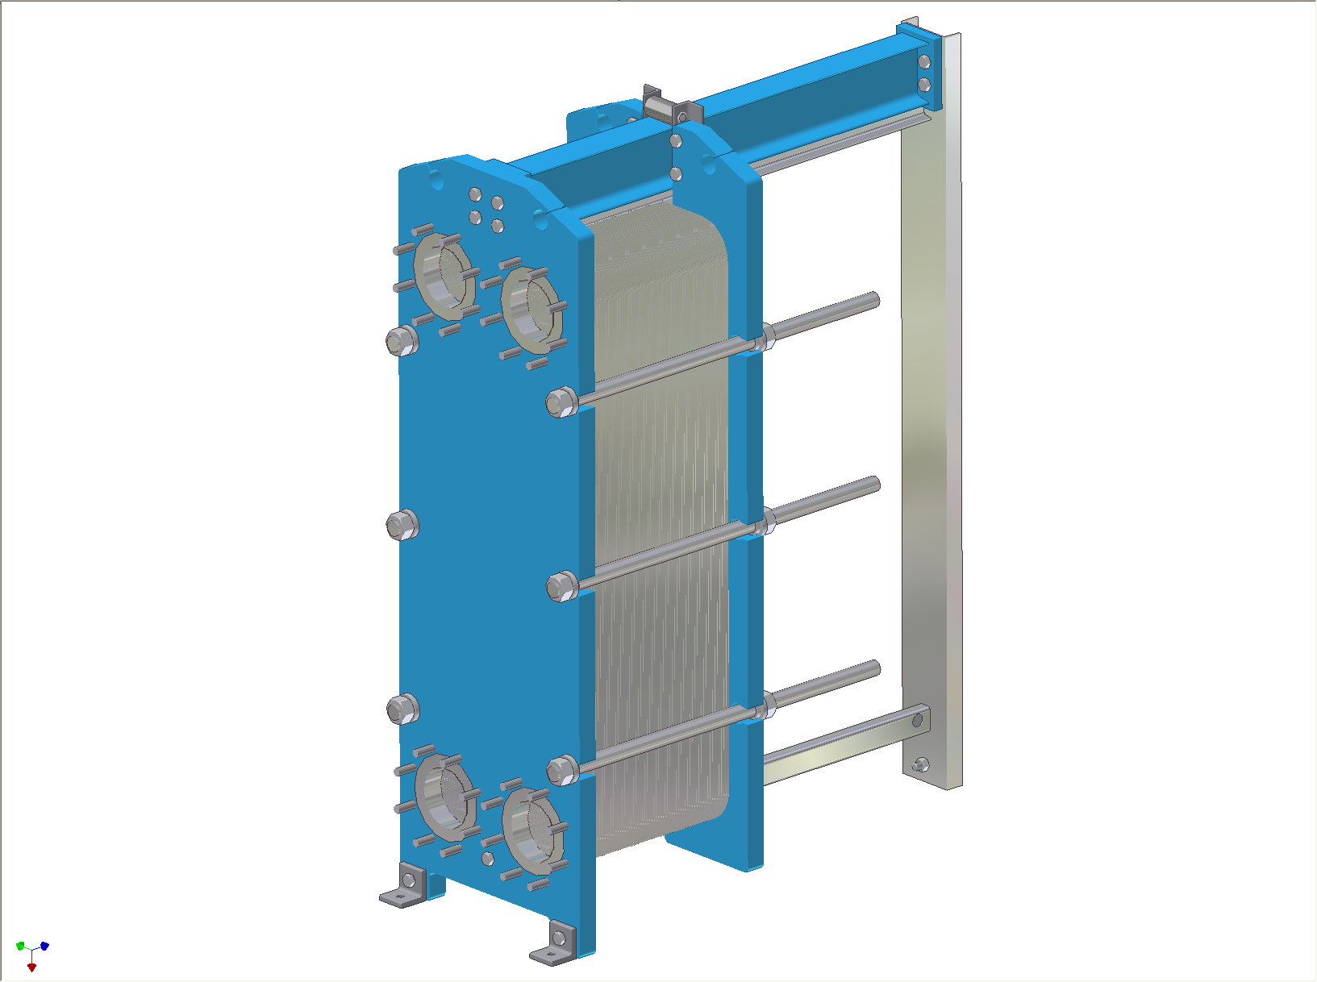
Frame Construction
Carrying Bar
Tightening Bolts
Plates / Plate Pack
Rear Support Column
Guiding Bar
Movable Head
Connection Port
Fixed Head

Slide 28
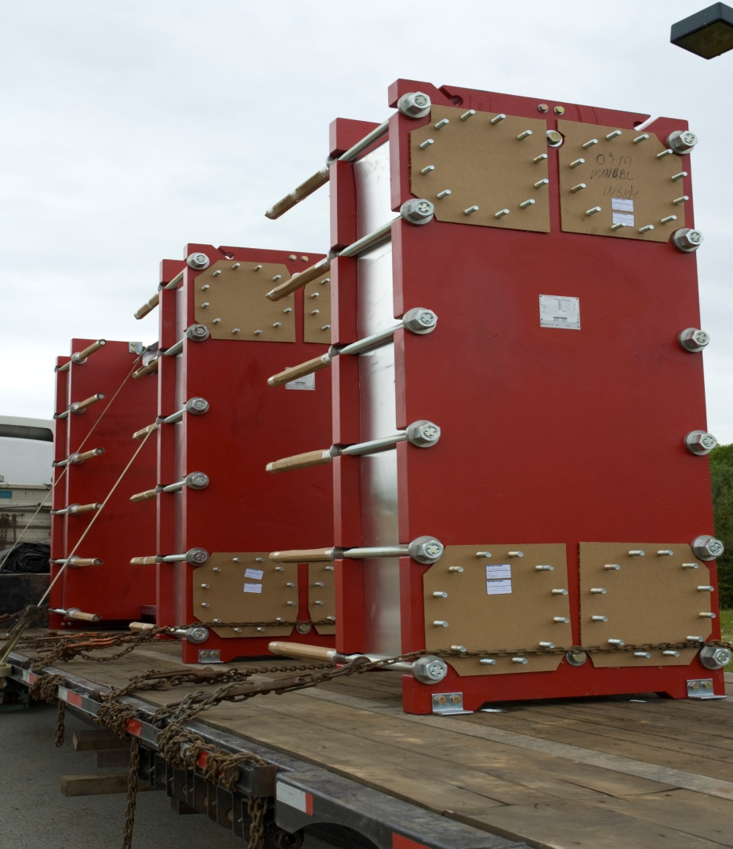

Frame Features
  ASME Section VIII for safety
  Canadian Registration
  All bolted construction for reassembly at job site
  Zinc plated tightening bolts
  Stainless steel plate carrying bars

Slide 29
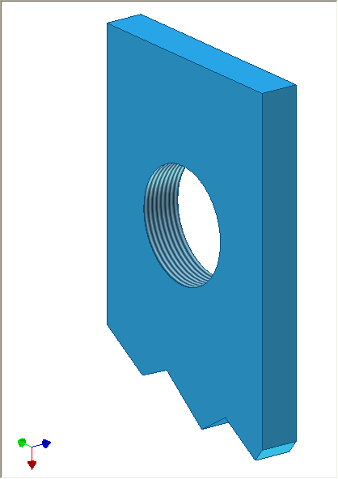
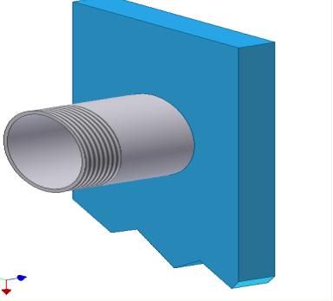
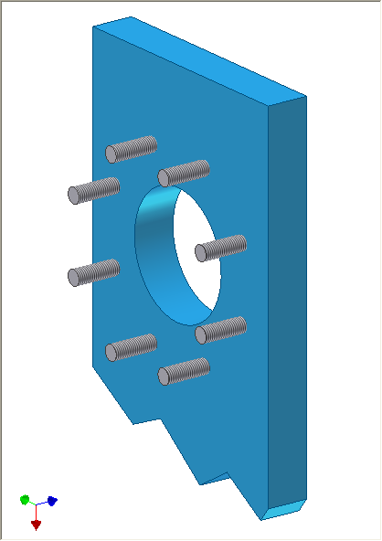
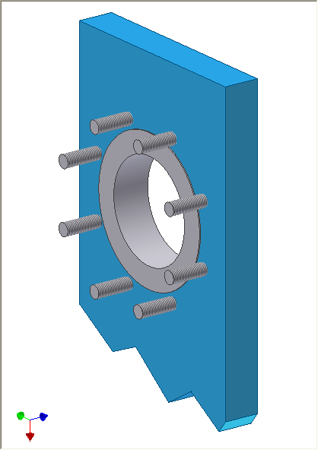
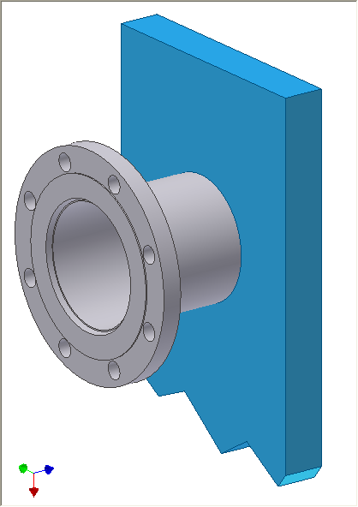
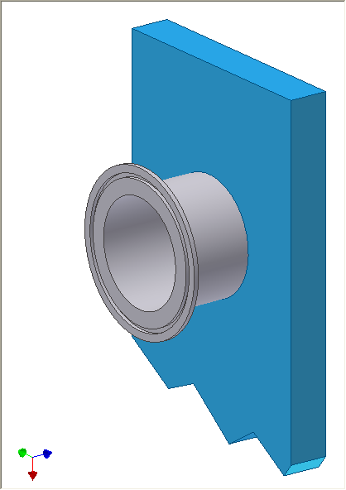
Connection Types
Standard
NPT Threaded
NPT Threaded
W/ Alloy Nozzle
ANSI Studded
ANSI Studded
W/ Alloy Liner
Use ANSI studded when flanged connections are specified for lowest cost
Optional
ANSI Flanged
Sanitary Ferrule
Quick Disconnect

Slide 30
Frame Features
  Many different sizes to be competitive
  Sized with 20% room for expansion w/ plates
  Connections sizes up to 14”
  Up to 400 psi working pressure

Slide 31
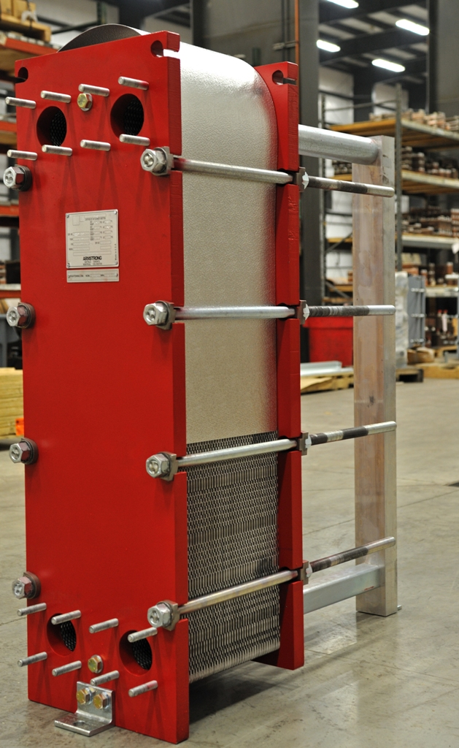
Frame Features
  Safety shield on every unit
  “OSHA Approved”
  Protects passerby from leaks
  Prolongs gasket life by limiting exposure to elements

Slide 32
PHE Benefits
EASY
SERVICING
MECHANICAL
CLEANING
POSSIBLE
ALL
BOLTED
CONSTRUCTION
REDESIGN
CAPABLITY
LOWER
MAINTENANCE
COSTS!!

Slide 33

Optional Construction
  Rigid insulation with drip tray
  All removeable
  For chilled water apps prevents sweating of heat exchanger
  Saves energy
  Cloth blanket insulation for heating applications

Slide 34


Advantage: Plates are key

Slide 35
The Plate

Slide 36
Plate Depth determines;
  Plate thickness
  Minimum tightening dimension
  Pressure rating
  Heat transfer rate
  Particle size to pass / fouling risk
  Typical plate depths are 0.1” minimum to 0.15” standard
  Some very wide gaps available

Slide 37
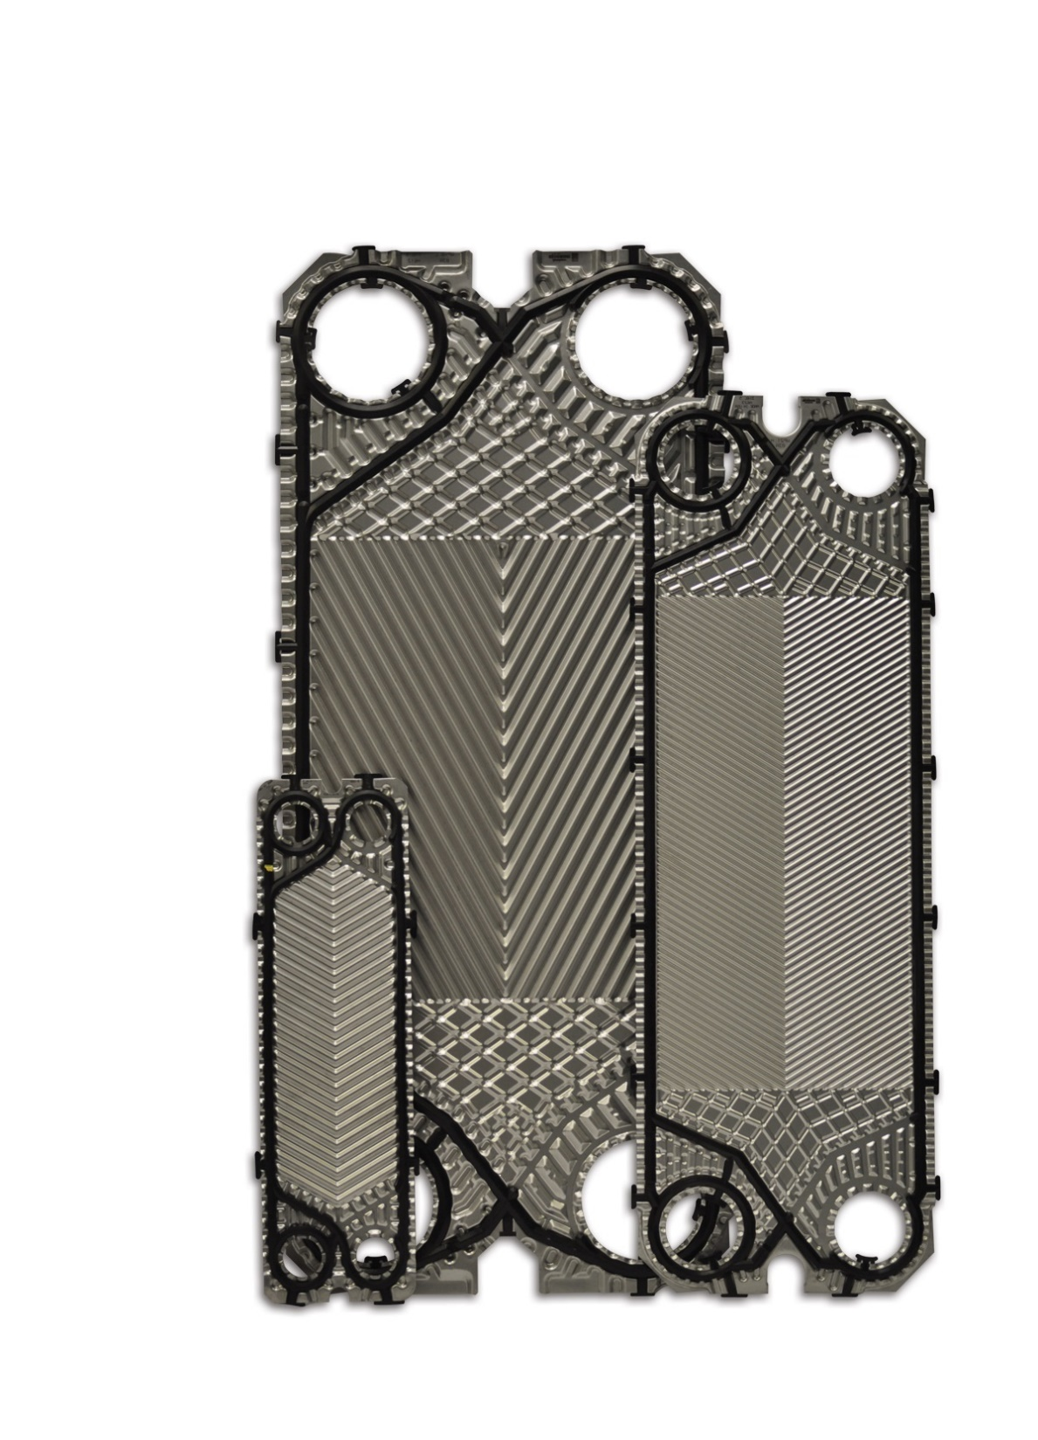
Advantage: Plates
  Many different plate sizes: 0.1” to 0.15” deep
  Use best plate styles that have been used for years – all AHRI approved
  All parallel flow; no diagonal
  Optimum distribution areas – no stagnant areas
  One time plate pressing
  Gasket 100% confined

Slide 38
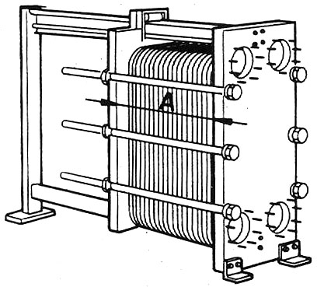
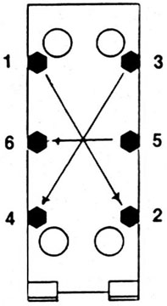

Tightening Dimension
Tightening dimension is critical for sealing heat exchangers properly.

Slide 39
Plates
  Plate Materials
    304 SS
    316 SS
    Titanium
  Plate Patterns
    H (High theta)
    L (Low theta)
  Plate Thickness
    0.4, 0.5, 0.6, 0.7 mm

Slide 40
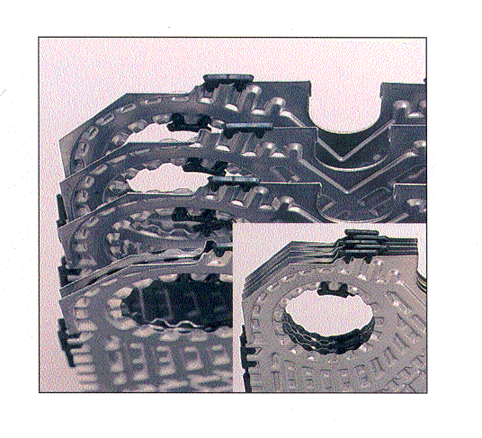
Plate Design
  Units with ports sizes 4” and smaller use a unique interlocking corner alignment system
  Guarantees proper alignment and sealing of heat exchanger

Slide 41
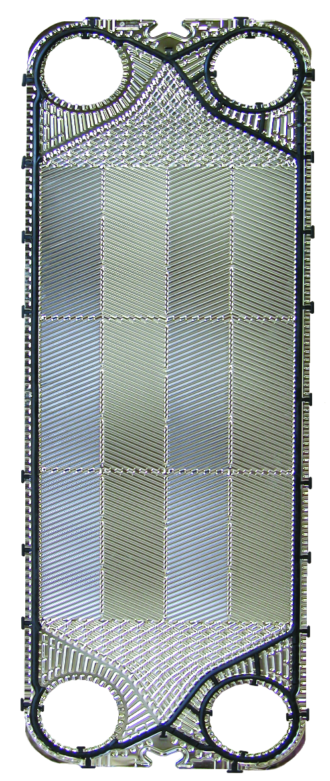
Plate Design
  Units with ports sizes 6” and larger use a unique 5 point alignment system
  Guarantees proper sealing of the heat exchanger while allowing for easy assembly and disassembly
“Plate cannot
shift in any
direction.”

Slide 42
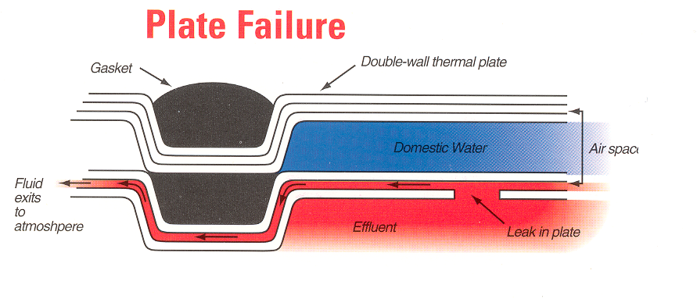

Double Wall Plate Geometry
Double wall plates protect one fluid from contaminating the other if a plate fails
Gasket
Double Wall Plate
Potable Water
Air Gap
Fluid leaks to
the outside.
Boiler Water
Plate Failure

Slide 43
Gasket Materials
  Nitrile (NBR)
    Good for general service
    230°F maximum
  EPDM
    Superior resistance to higher temperatures i.e. steam
    Longer gasket life
    320° F maximum
  Life expectancy of gaskets is 5 years based on temperatures listed above

Slide 44
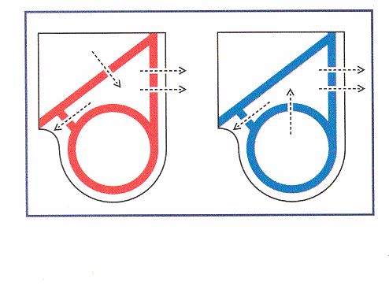
Gasket Design
Gasket failures always are to the outside of the heat exchanger

Slide 45
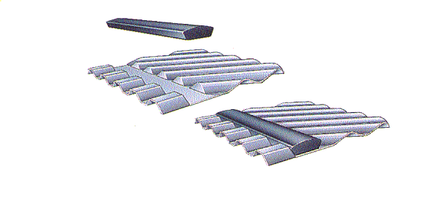
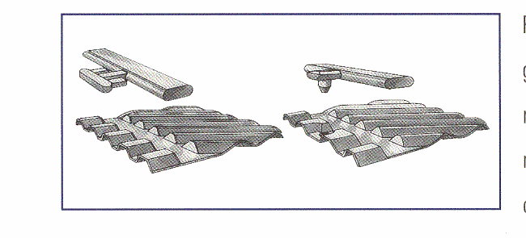
Gluefree Gaskets
  Gluefree
  Glued

Slide 46
Gaske Design sealing
Gasket Design
  Ridged Gaskets
plate Others
  Higher sealing pressures
  Better sealing of heat exchanger
  Longer life and reliability

Slide 47
PHE Certifications
  ASME Section VIII
  CRN
  AHRI Performance Certification
    January 2015

Slide 48


Plate Models / Sizes
14”
10”
8”
Connection Sizes
4”
6”
WP140
WP101
WP45
WP80
WP81
WP60
WP61
2”
1”
WP40
WP41
WP20
WP21
WP10

Slide 49

AHRI Performance Certification
  AHRI Certification
  Standard 400 for Liquid to Liquid Heat Exchangers
  Product listed at www.ahridirectory.com
  Guarantee of performance by third party

Slide 50
AHRI Performance Certification
  As required by ASHRAE 90.1 and individual engineers
  Applications that are exempt;
    Glycol applications
    Flows over 2,000 gpm
  ASHRAE 90.1 accepted by some states

Slide 51

Heat Transfer Products
The End
Thank You

